Slide 1
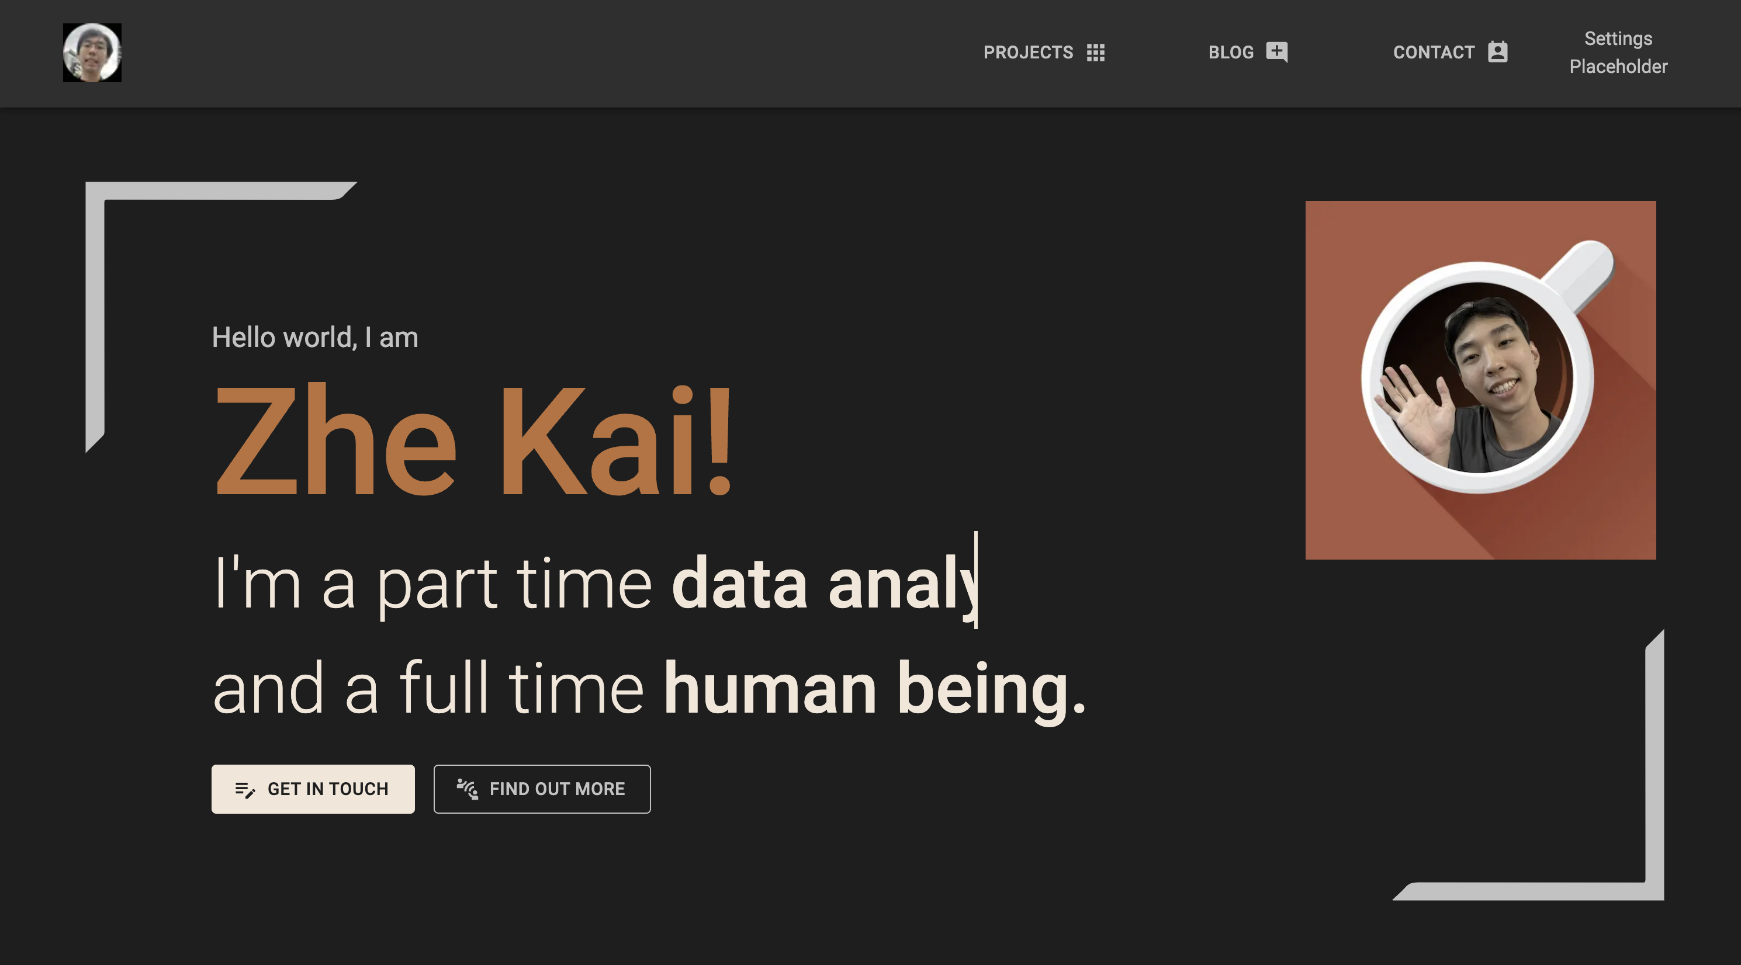



A short word…
Hi there! I’m Zhe Kai, a penultimate year Computer Science scholar from the Renaissance Engineering Program in NTU. I’m an aspiring Software Engineer, with a focus on Backend Development. Welcome to my website!
Proficiencies at a glance
Backend Development
Frontend Development
Development & Operations
Data Analytics and Machine Learning
Languages
Other random hobbies
Low Zhe Kai © 2023 All Right Reserved

